Slide 1


Domain Generalization
Presentation by: Abolfazl (Babak) Ettehadieh
Course: Trustworthy A.I by Dr. Tavassolipour
Winter 2025

Slide 2
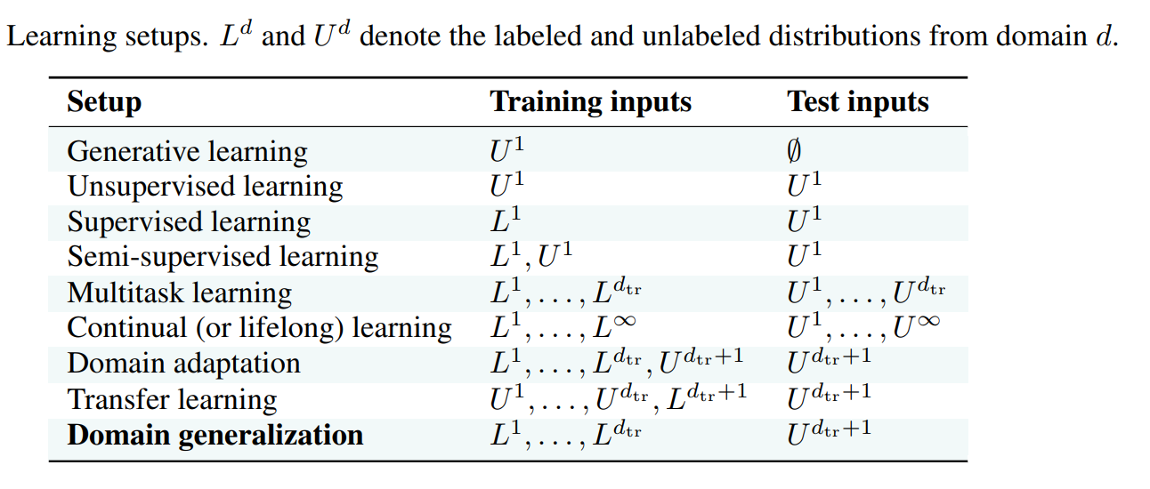
Domain Generalization and related areas

Slide 3
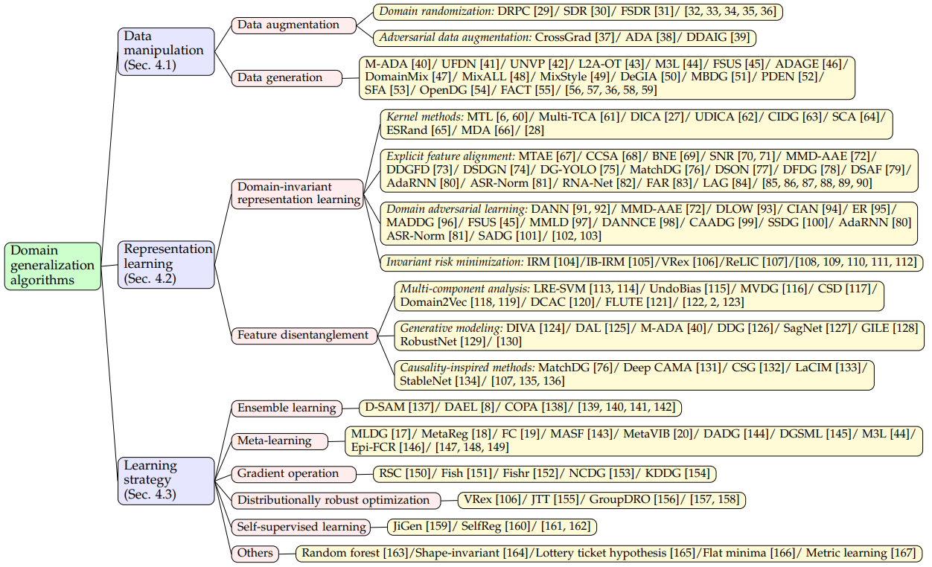
MIRO
RDM

Slide 4
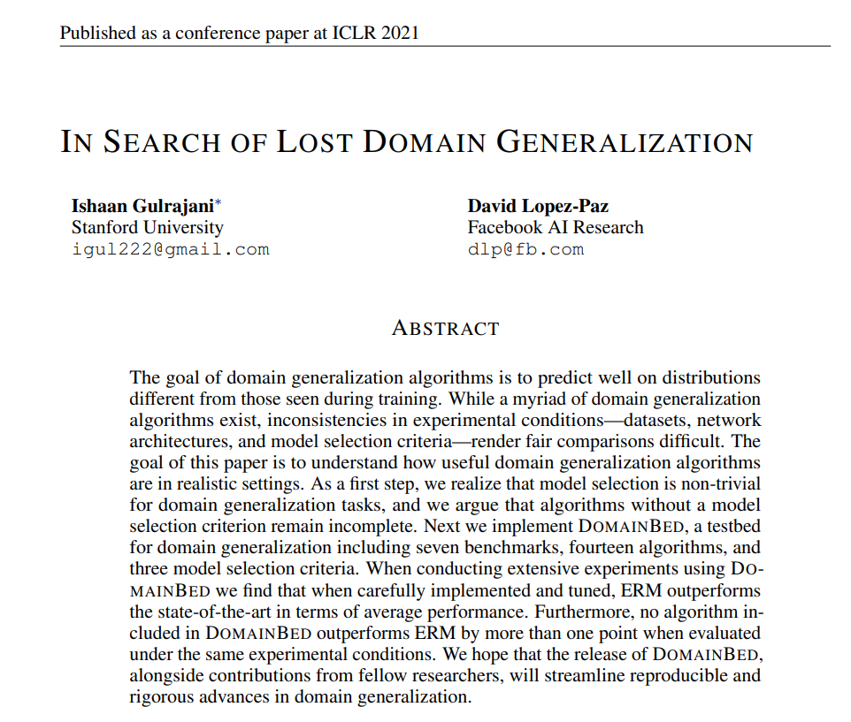

Slide 5
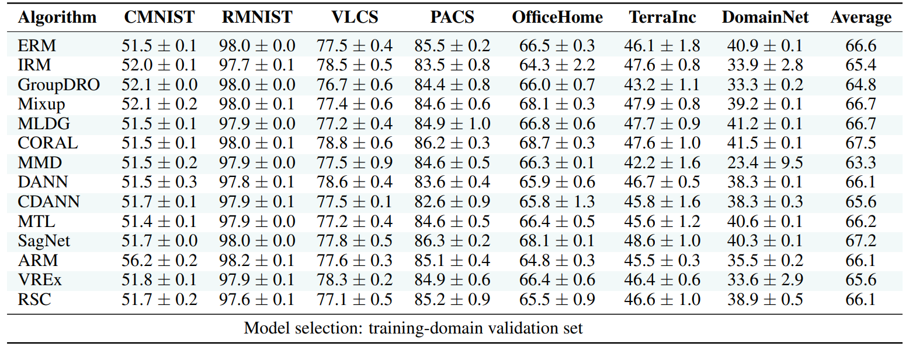
DomainBed : A Pytorch Testbed for DG
https://github.com/facebookresearch/DomainBed/.
Recently, DomainBed includes about 32 algorithms and 12 datasets and 3 model selection methods.

Slide 6
Model Selection
Three model selection methods for DG:
Training-domain validation
Leave-one-domain-out validation
Test-domain validation

Slide 7
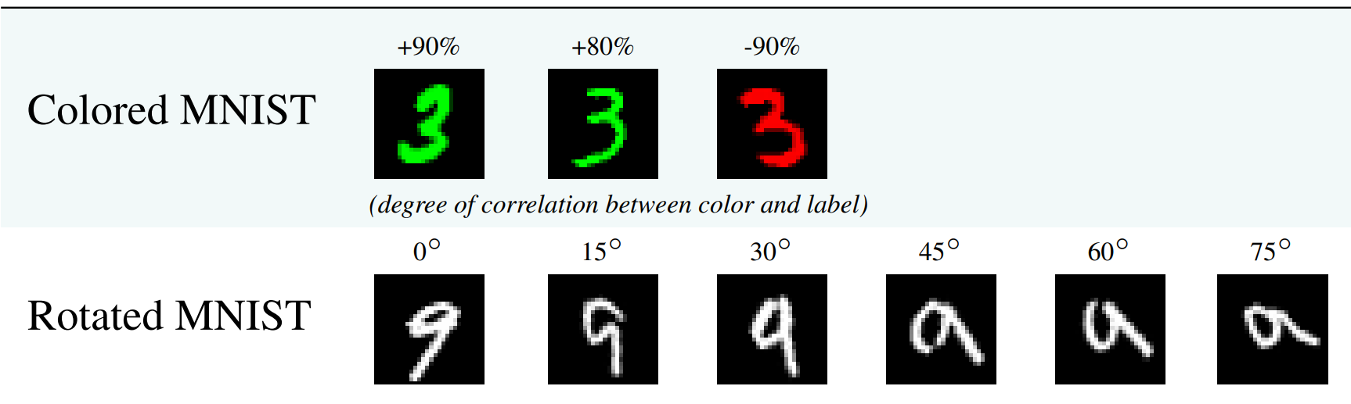
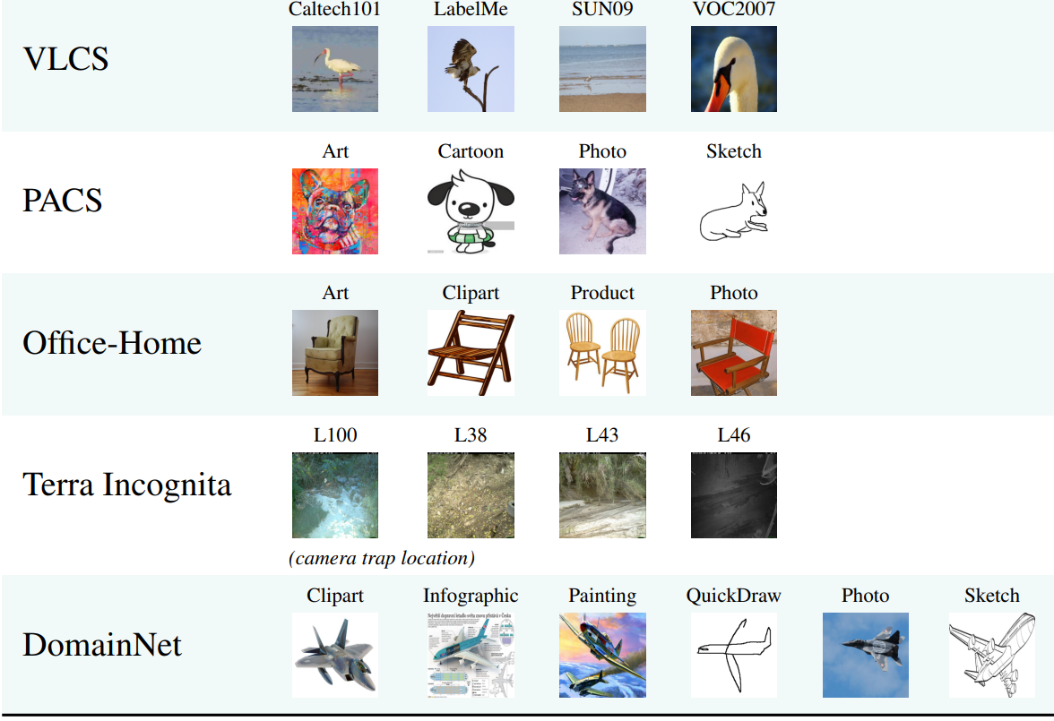

Slide 8
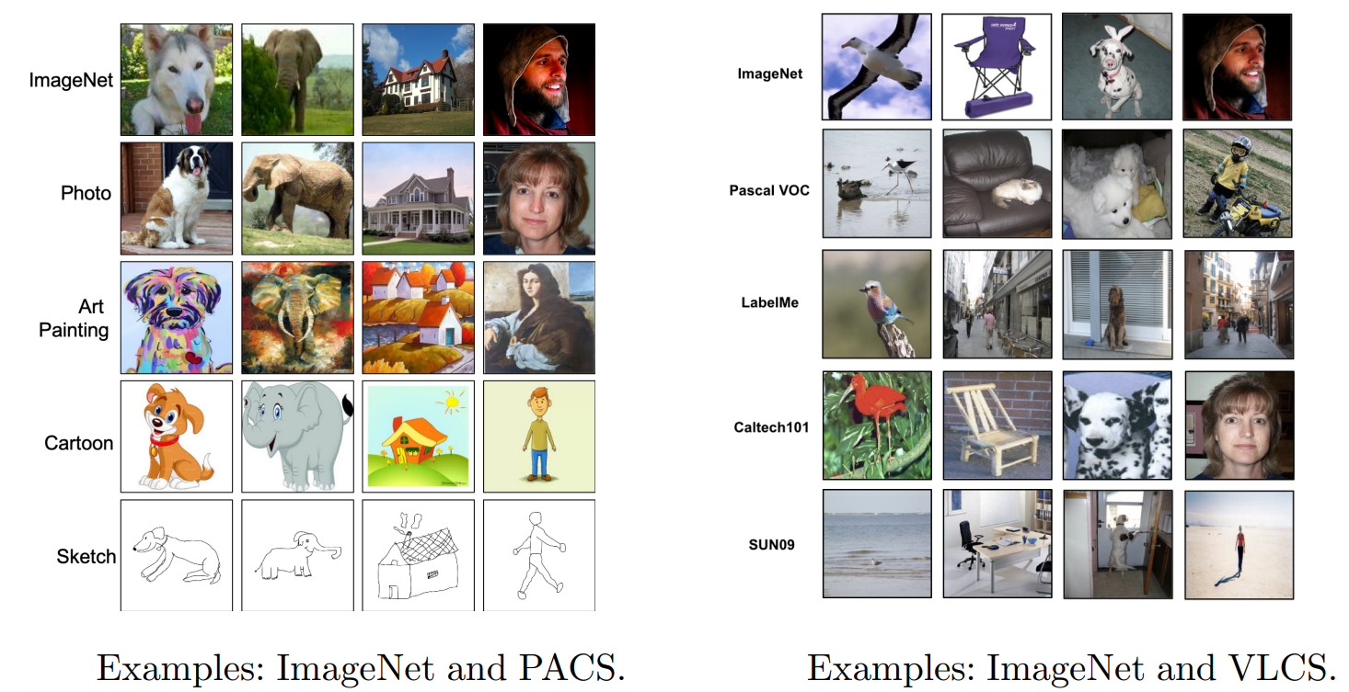

Slide 9
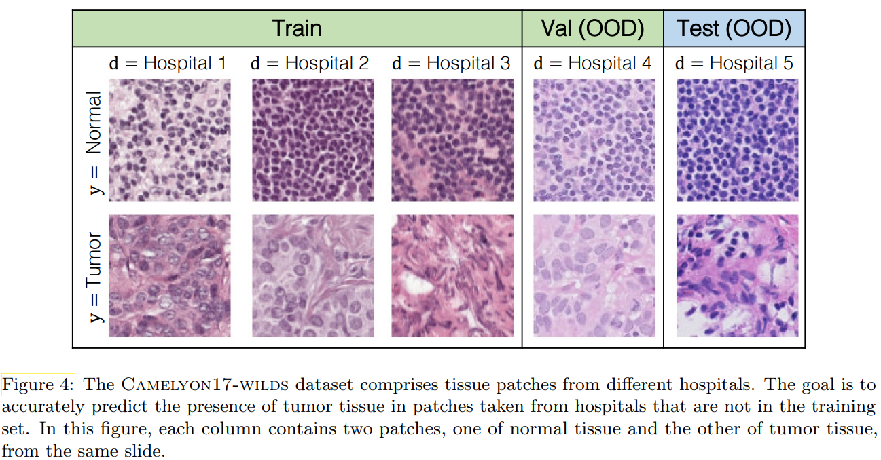
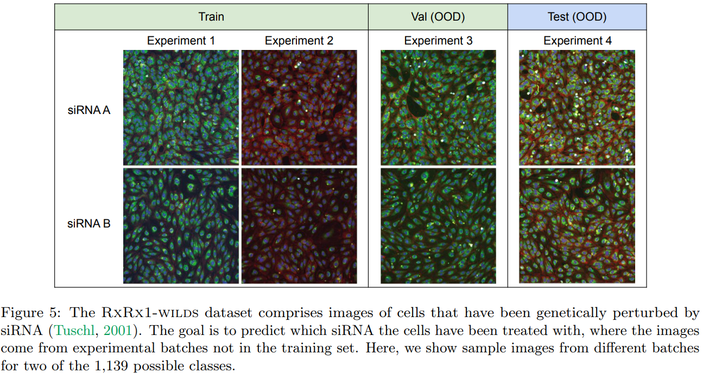
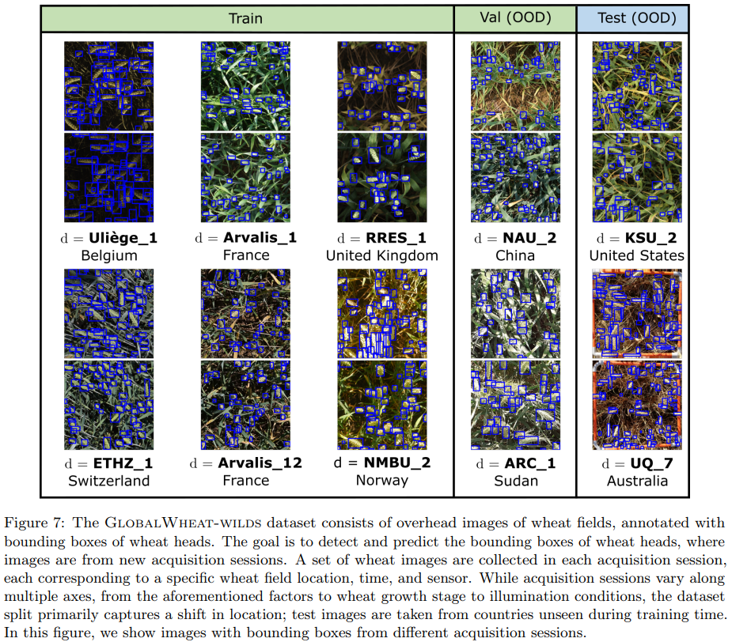
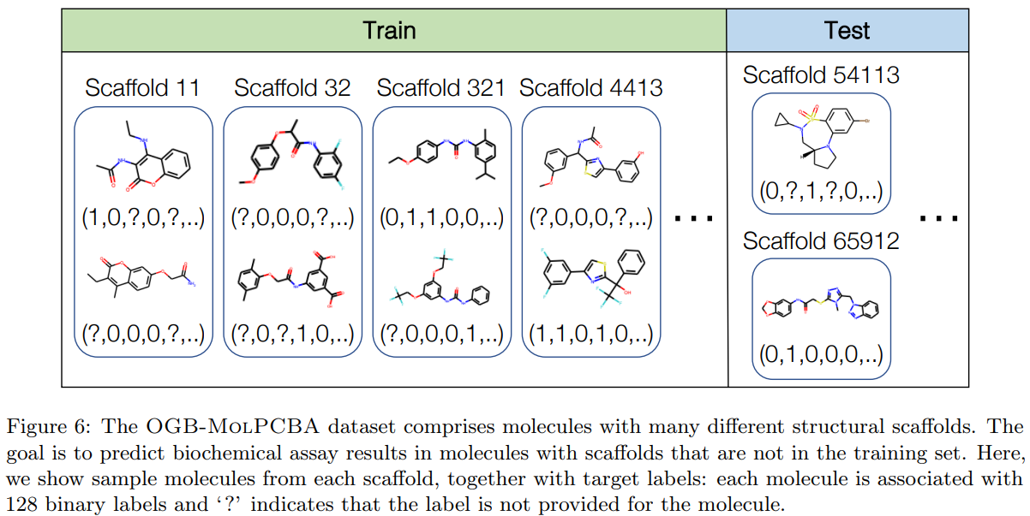
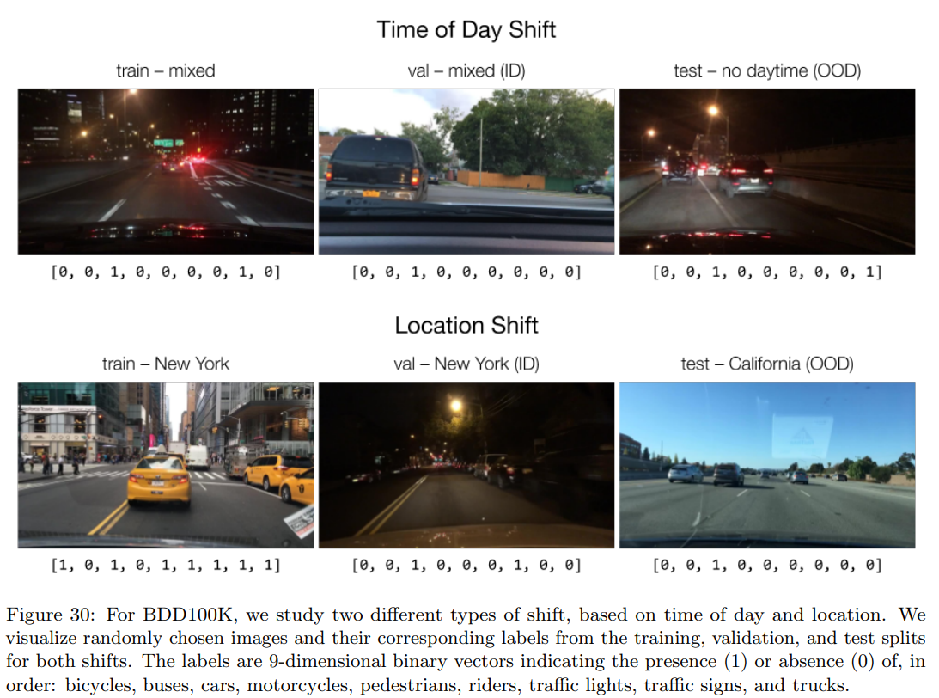
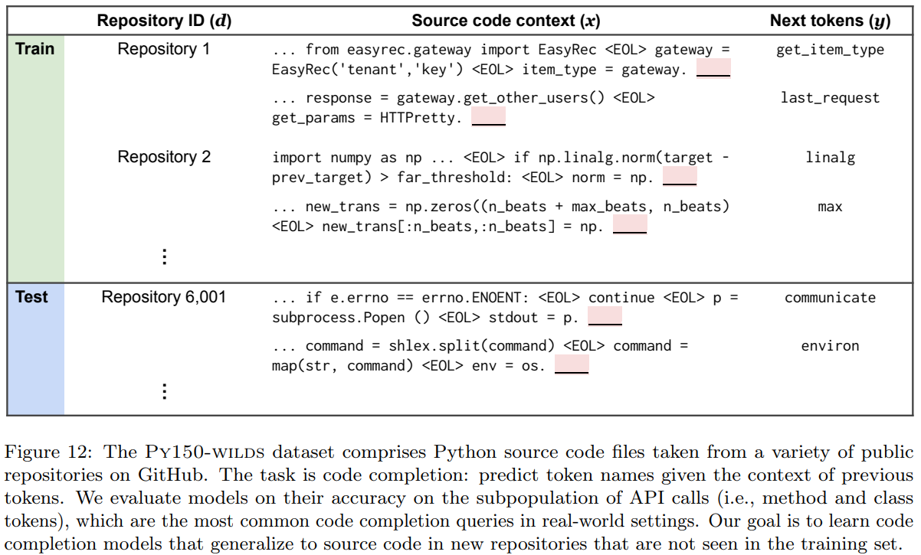
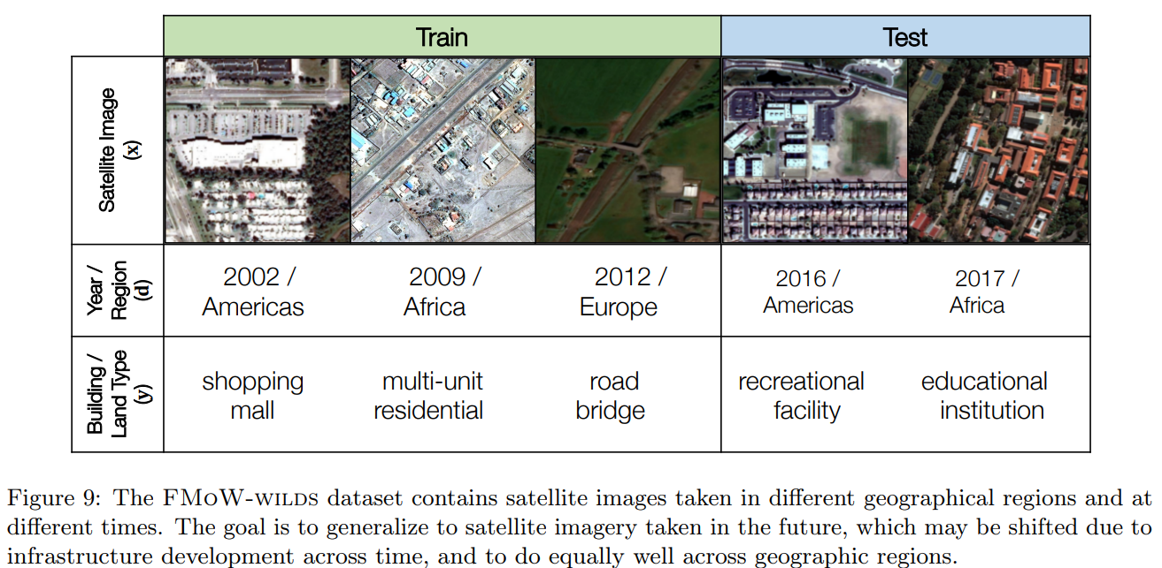
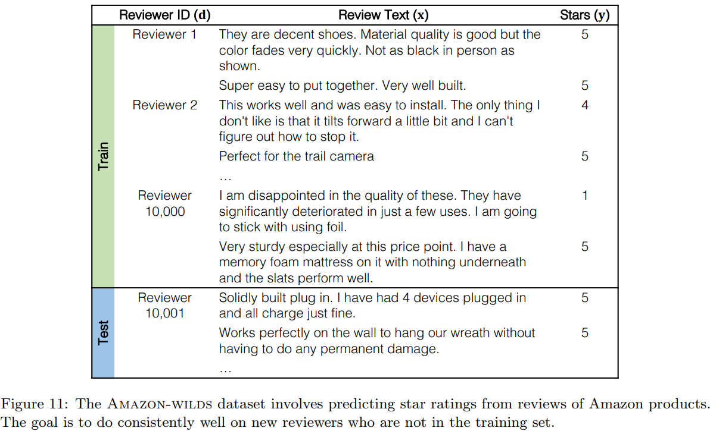
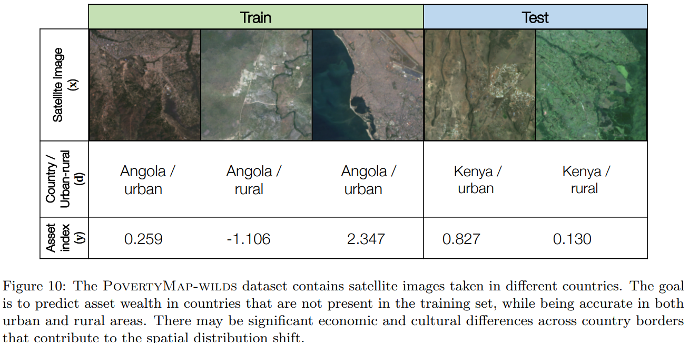
Domain Generalization in real world datasets and problems:

Slide 10
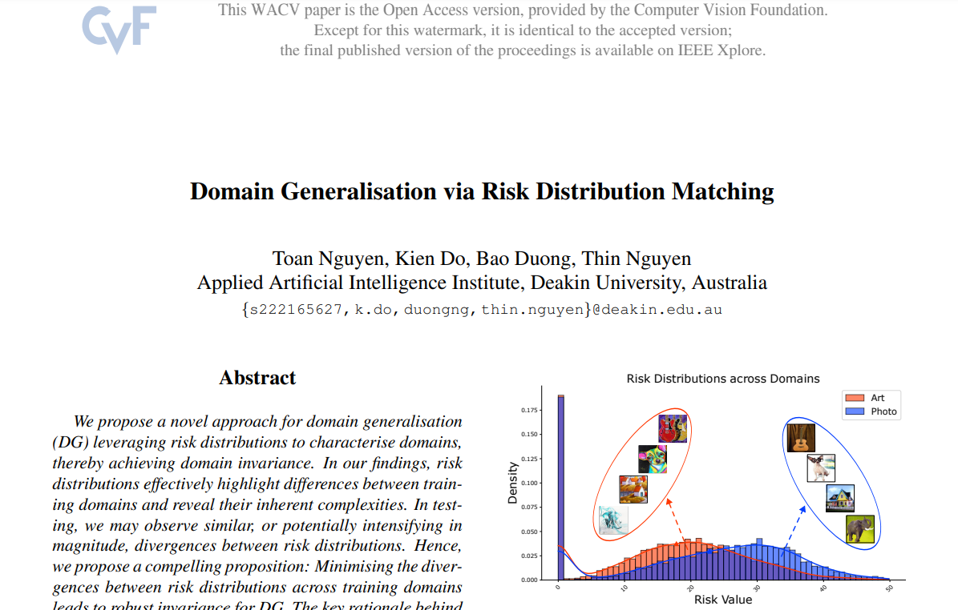

Slide 11
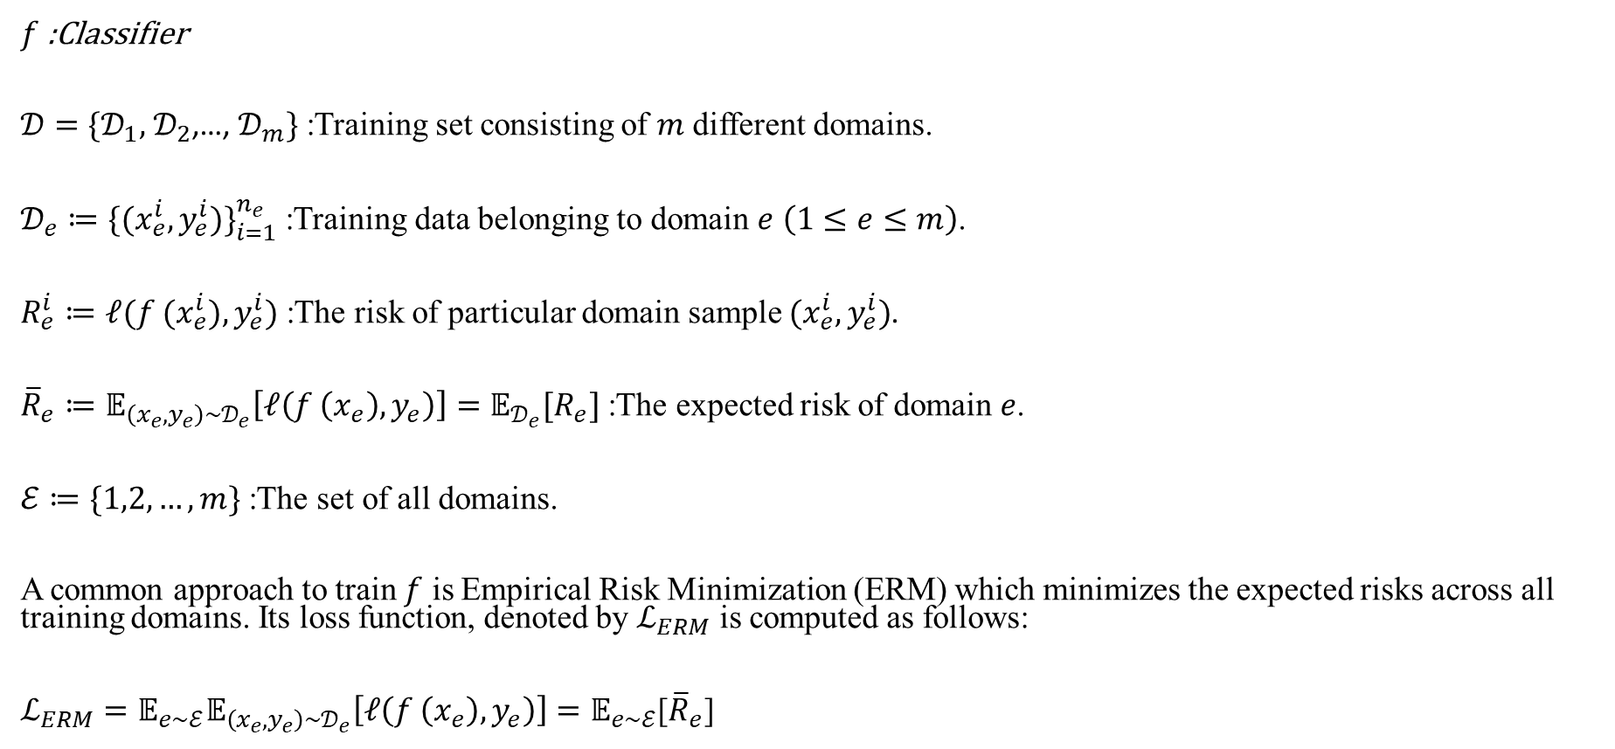
Empirical Risk Minimization (ERM)
$f$ :Classifier
$𝒟=\{𝒟_{1},$ $𝒟_{2}$,…, $𝒟_{m}\}$ :Training set consisting of $m$ different domains.
$𝒟_{e}≔{\{(x_{e}^{i},y_{e}^{i})\}}_{i=1}^{n_{e}}$ :Training data belonging to domain $e$ $\left(1≤e≤m\right)$.
$R_{e}^{i}≔ℓ(f (x_{e}^{i}),y_{e}^{i})$ :The risk of particular domain sample $(x_{e}^{i},y_{e}^{i})$.
${\overline{R}}_{e}≔𝔼_{\left(x_{e},y_{e}\right)\sim 𝒟_{e}}\left[ℓ\left(f \left(x_{e}\right),y_{e}\right)\right]=𝔼_{𝒟_{e}}[R_{e}]$ :The expected risk of domain $e$.
$ℰ≔\{1,2,…,m\}$ :The set of all domains.
A common approach to train $f$ is Empirical Risk Minimization (ERM) which minimizes the expected risks across all training domains. Its loss function, denoted by $ℒ_{ERM}$ is computed as follows:
$ℒ_{ERM}=𝔼_{e\sim ℰ}𝔼_{\left(x_{e},y_{e}\right)\sim 𝒟_{e}}\left[ℓ\left(f \left(x_{e}\right),y_{e}\right)\right]=𝔼_{e\sim ℰ}$[${\overline{R}}_{e}$]

Slide 12
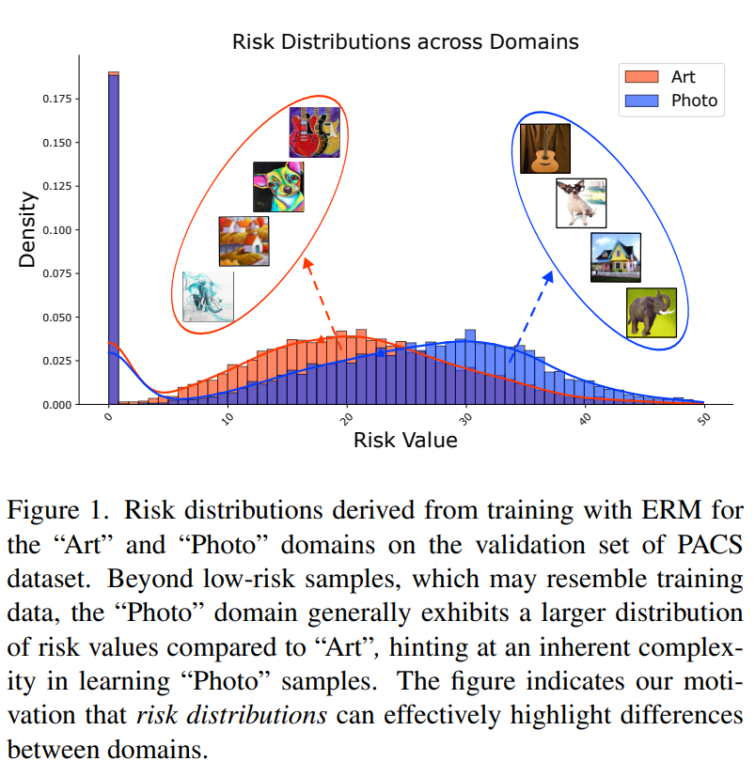

Slide 13
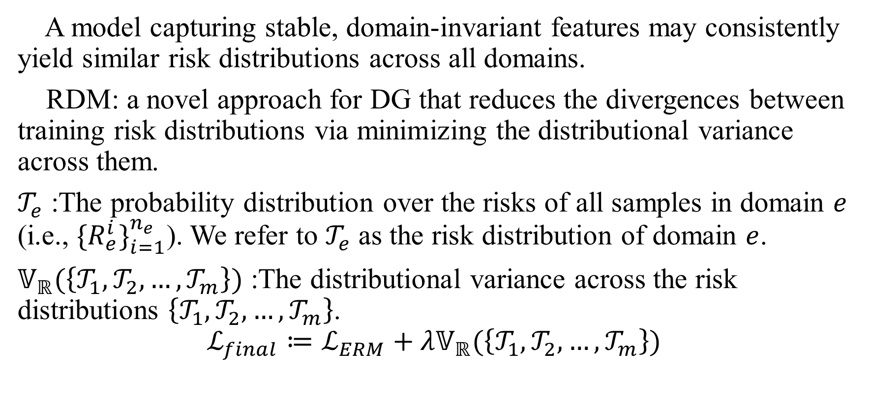
Risk Distribution Matching (RDM)
A model capturing stable, domain-invariant features may consistently yield similar risk distributions across all domains.
RDM: a novel approach for DG that reduces the divergences between training risk distributions via minimizing the distributional variance across them.
$𝒯_{e}$ :The probability distribution over the risks of all samples in domain $e$ (i.e., ${\{R_{e}^{i}\}}_{i=1}^{n_{e}}$). We refer to $𝒯_{e}$ as the risk distribution of domain $e$.
$𝕍_{ℝ}(\left\{𝒯_{1},𝒯_{2},…,𝒯_{m}\right\})$ :The distributional variance across the risk distributions $\left\{𝒯_{1},𝒯_{2},…,𝒯_{m}\right\}$.
$$ℒ_{final}≔ℒ_{ERM}+λ𝕍_{ℝ}(\left\{𝒯_{1},𝒯_{2},…,𝒯_{m}\right\})$$

Slide 14
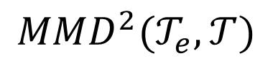
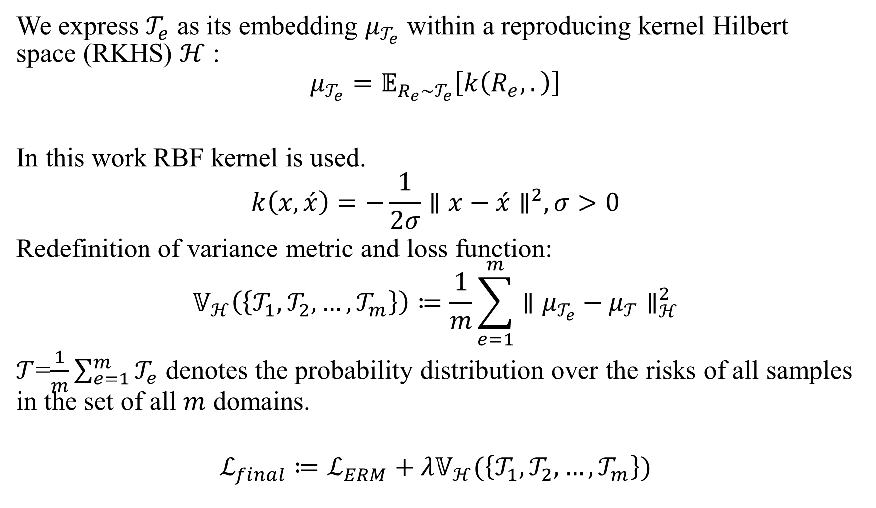
We express $𝒯_{e}$ as its embedding $μ_{𝒯_{e}}$ within a reproducing kernel Hilbert space (RKHS) $ℋ$ :
$$μ_{𝒯_{e}}=𝔼_{R_{e}\sim 𝒯_{e}}\left[k\left(R_{e},.\right)\right]$$
In this work RBF kernel is used.
$$k\left(x,\acute{x}\right)=−\frac{1}{2σ}{∥x−\acute{x}∥}^{2},σ>0$$
Redefinition of variance metric and loss function:
$$𝕍_{ℋ}\left(\left\{𝒯_{1},𝒯_{2},…,𝒯_{m}\right\}\right)≔\frac{1}{m}\sum_{e=1}^{m}{{∥μ_{𝒯_{e}}−μ_{𝒯}∥}_{ℋ}^{2}}$$
$𝒯$=$\frac{1}{m}\sum_{e=1}^{m}{𝒯_{e}}$ denotes the probability distribution over the risks of all samples in the set of all $m$ domains.
$$ℒ_{final}≔ℒ_{ERM}+λ𝕍_{ℋ}(\left\{𝒯_{1},𝒯_{2},…,𝒯_{m}\right\})$$
$${MMD}^{2}(𝒯_{e},𝒯)$$

Slide 15
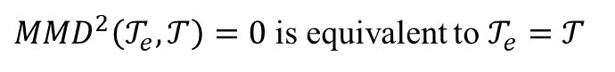
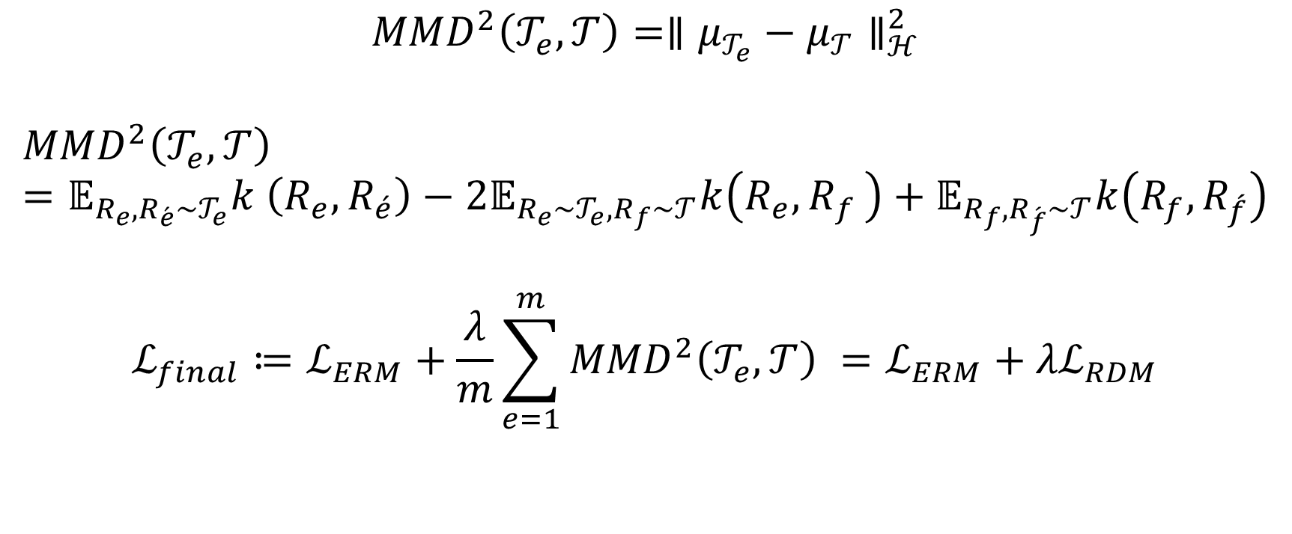
Maximum Mean Discrepancy (MMD)
$${MMD}^{2}\left(𝒯_{e},𝒯\right)={∥μ_{𝒯_{e}}−μ_{𝒯}∥}_{ℋ}^{2}$$
$${MMD}^{2}\left(𝒯_{e},𝒯\right)=𝔼_{R_{e},R_{\acute{e}}\sim 𝒯_{e}}k \left(R_{e},R_{\acute{e}}\right)−2𝔼_{R_{e}\sim 𝒯_{e},R_{f}\sim 𝒯}k\left(R_{e}{,R}_{f}\right)+𝔼_{R_{f},R_{\acute{f}}\sim 𝒯}k\left(R_{f},R_{\acute{f}}\right)$$
$$ℒ_{final}≔ℒ_{ERM}+\frac{λ}{m}\sum_{e=1}^{m}{{MMD}^{2}\left(𝒯_{e},𝒯\right) }=ℒ_{ERM}+{λℒ}_{RDM}$$
${MMD}^{2}\left(𝒯_{e},𝒯\right)=0$ is equivalent to $𝒯_{e}=𝒯$

Slide 16
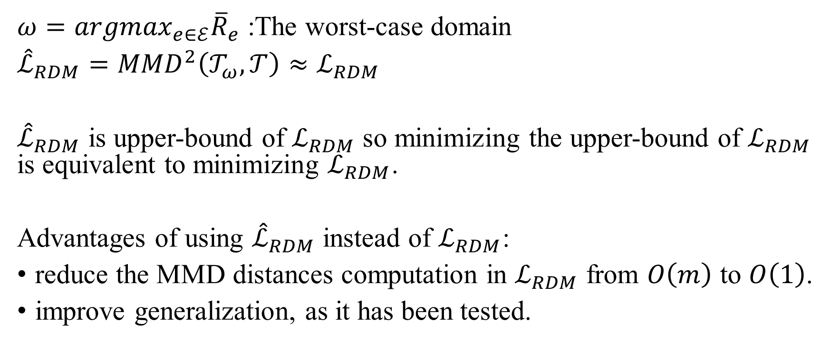
Further improvement of RDM
$ω={argmax}_{e∈ℰ}{\overline{R}}_{e}$ :The worst-case domain
${\hat{ℒ}}_{RDM}={MMD}^{2}\left(𝒯_{ω},𝒯\right)≈ℒ_{RDM}$
${\hat{ℒ}}_{RDM}$ is upper-bound of $ℒ_{RDM}$ so minimizing the upper-bound of $ℒ_{RDM}$ is equivalent to minimizing $ℒ_{RDM}$.
Advantages of using ${\hat{ℒ}}_{RDM}$ instead of $ℒ_{RDM}$:
reduce the MMD distances computation in $ℒ_{RDM}$ from $O\left(m\right)$ to $O\left(1\right)$.
improve generalization, as it has been tested.

Slide 17
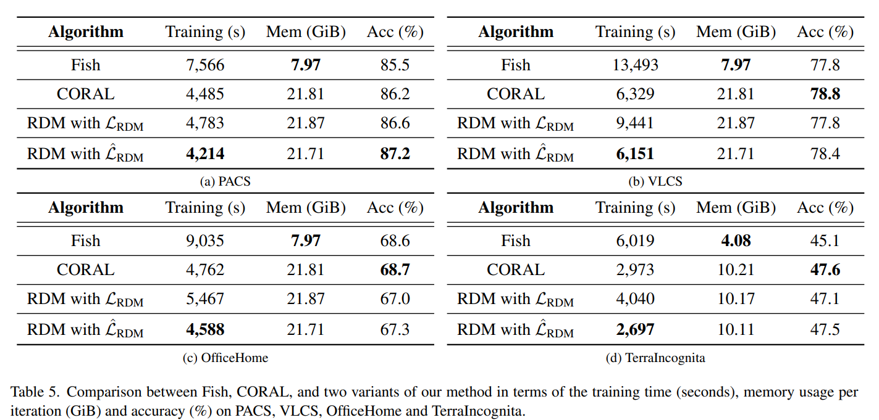
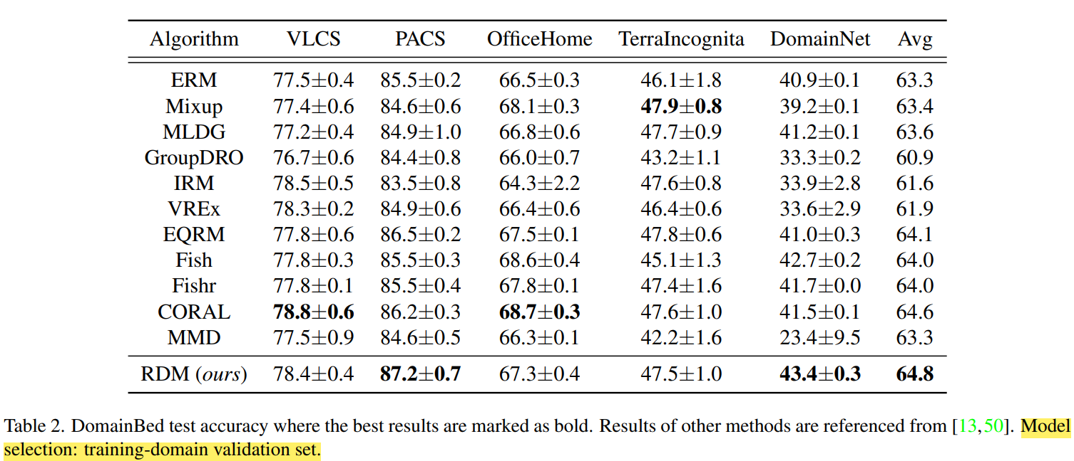
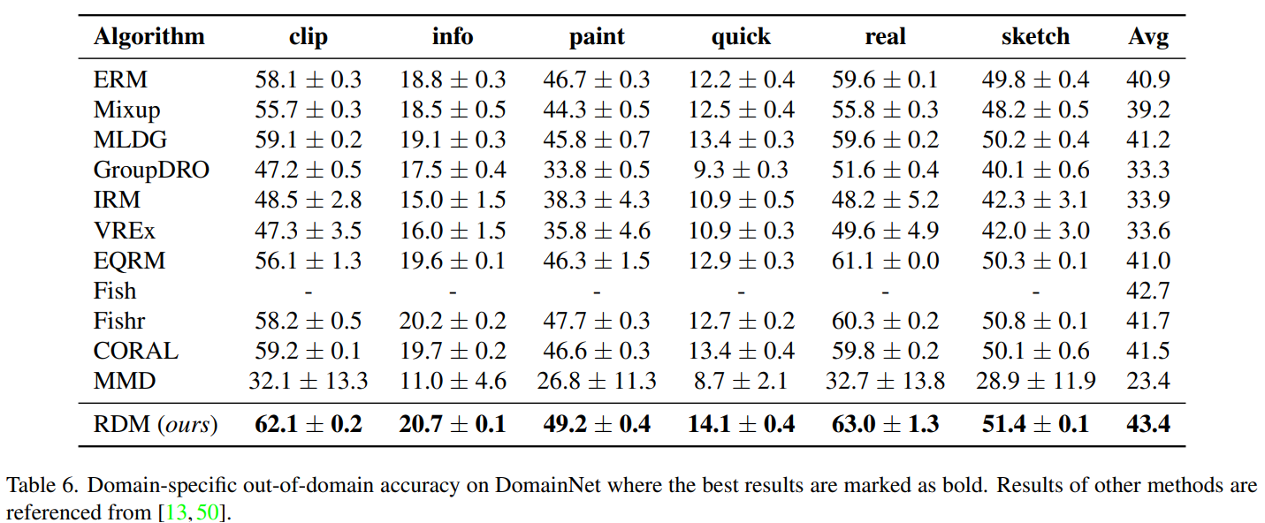
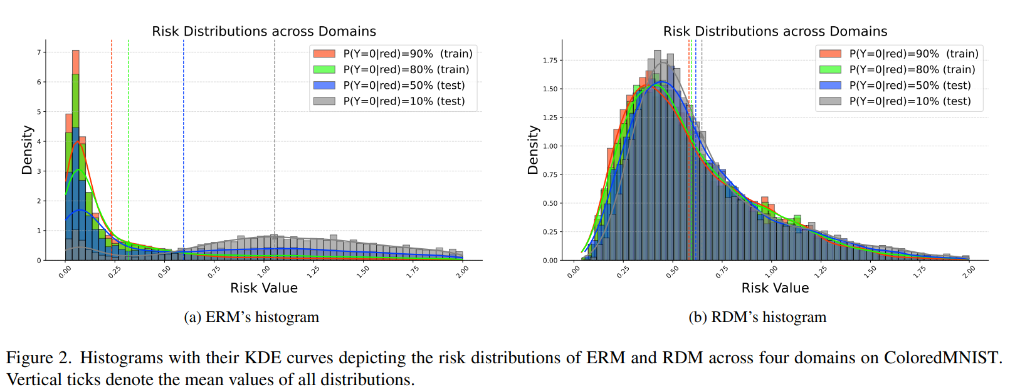
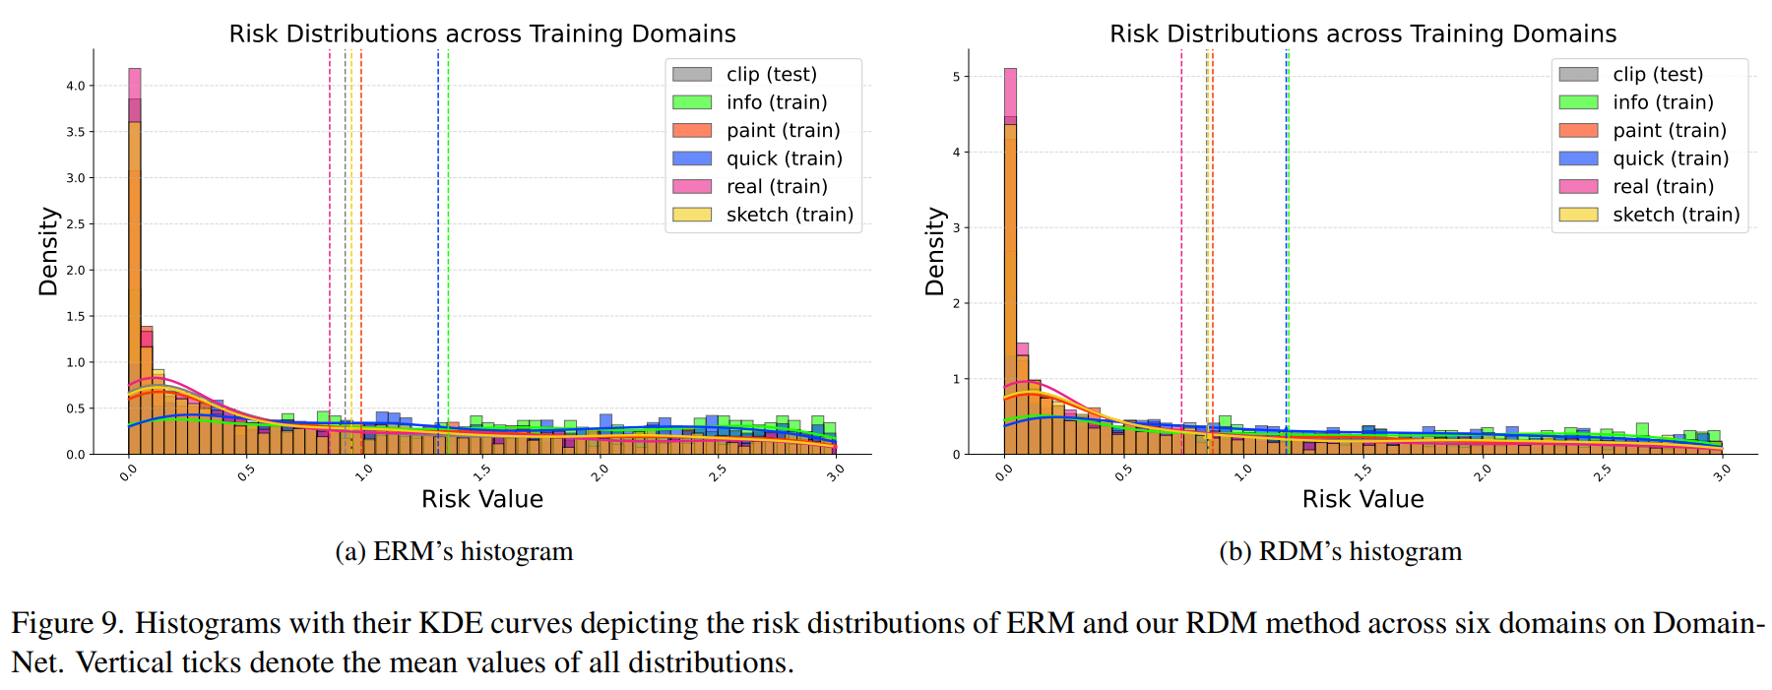
Experiments

Slide 18
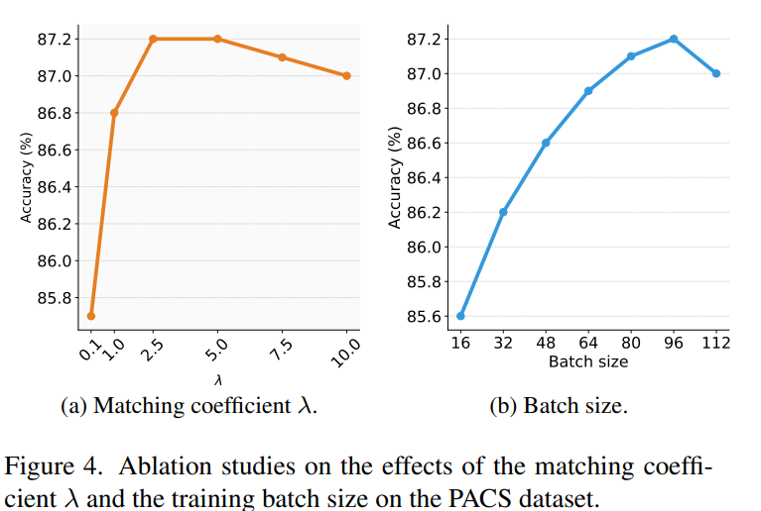
In the domain generalization methods presented so far, the batch size reported to yield the highest accuracy has been 32 and at most 64. The need for a large batch size in this method is one of the factors that leads to high computational costs.
Why large batch size is needed in this method?

Slide 19


Mutual Information Regularization with Oracle (MIRO)
Learning domain invariant features
Let a model learn similar features to “oracle” representations
Oracle : An optimal model generalized to any domain.
But, how to access Oracle?!
Approximate the oracle by a large pre-trained model

Slide 20
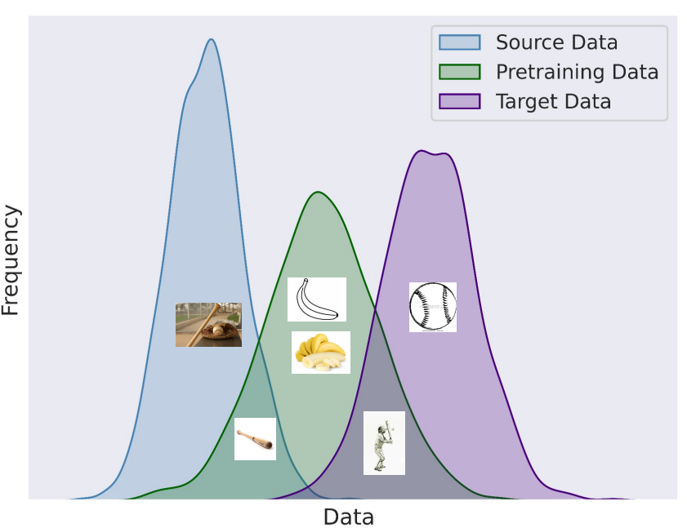
Preventing catastrophic forgetting of good initializations with an appropriate regularizer

Slide 21
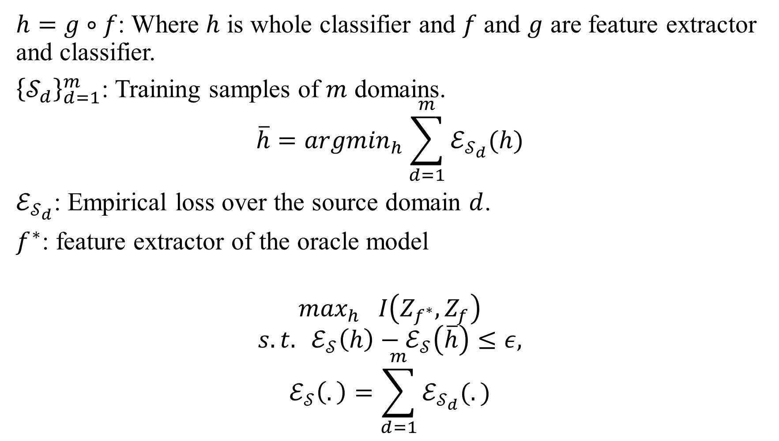
$h=g∘f$: Where $h$ is whole classifier and $f$ and $g$ are feature extractor and classifier.
${\left\{𝒮_{d}\right\}}_{d=1}^{m}$: Training samples of $m$ domains.
$$\overline{h}={argmin}_{h}\sum_{d=1}^{m}{ℰ_{𝒮_{d}}(h)}$$
$ℰ_{𝒮_{d}}$: Empirical loss over the source domain $d$.
$f^{∗}$: feature extractor of the oracle model
$$\max_{h} I\left(Z_{f^{∗}},Z_{f}\right)$$
$$s.t. ℰ_{𝒮}\left(h\right)−ℰ_{𝒮}\left(\overline{h}\right)≤ε,$$
$$ℰ_{𝒮}\left(.\right)=\sum_{d=1}^{m}{ℰ_{𝒮_{d}}(.)}$$

Slide 22
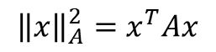
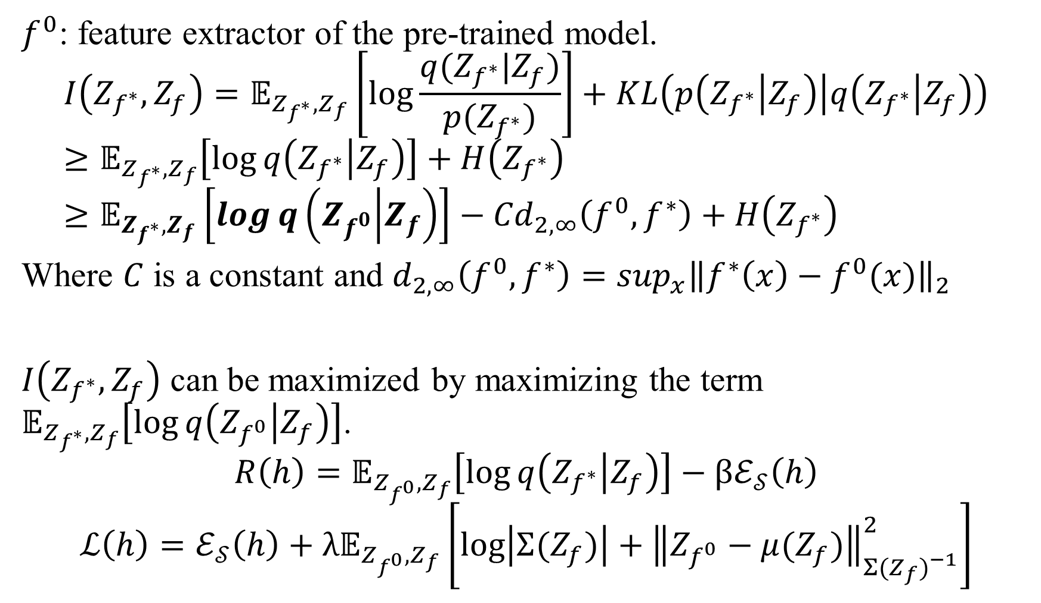
$f^{0}$: feature extractor of the pre-trained model.
$$I\left(Z_{f^{∗}},Z_{f}\right)=𝔼_{Z_{f^{∗}},Z_{f}}\left[\log{\frac{q(Z_{f^{∗}}|Z_{f})}{p(Z_{f^{∗}})}}\right]+KL\left(p\left(Z_{f^{∗}} | Z_{f}\right) | q\left(Z_{f^{∗}} | Z_{f}\right)\right)≥𝔼_{Z_{f^{∗}},Z_{f}}\left[\log{q\left(Z_{f^{∗}} | Z_{f}\right)}\right]+H\left(Z_{f^{∗}}\right)≥𝔼_{Z_{f^{∗}},Z_{f}}\left[\log{q\left(Z_{f^{0}} | Z_{f}\right)}\right]−{Cd}_{2,∞}\left(f^{0},f^{∗}\right)+H\left(Z_{f^{∗}}\right)$$
Where $C$ is a constant and $d_{2,∞}\left(f^{0},f^{∗}\right)=\sup_{x}{\left\|f^{∗}\left(x\right)−f^{0}(x)\right\|}_{2}$
$I\left(Z_{f^{∗}},Z_{f}\right)$ can be maximized by maximizing the term $𝔼_{Z_{f^{∗}},Z_{f}}\left[\log{q\left(Z_{f^{0}} | Z_{f}\right)}\right]$.
$$R\left(h\right)=𝔼_{Z_{f^{0}},Z_{f}}\left[\log{q\left(Z_{f^{∗}} | Z_{f}\right)}\right]−βℰ_{𝒮}\left(h\right)$$
$$ℒ\left(h\right)=ℰ_{𝒮}\left(h\right)+λ𝔼_{Z_{f^{0}},Z_{f}}\left[\log\left|Σ(Z_{f})\right|+{\left\|Z_{f^{0}}−μ(Z_{f})\right\|}_{{Σ(Z_{f})}^{−1}}^{2}\right]$$
Constraint of the problem
$${\left\|x\right\|}_{A}^{2}=x^{T}Ax$$

Slide 23
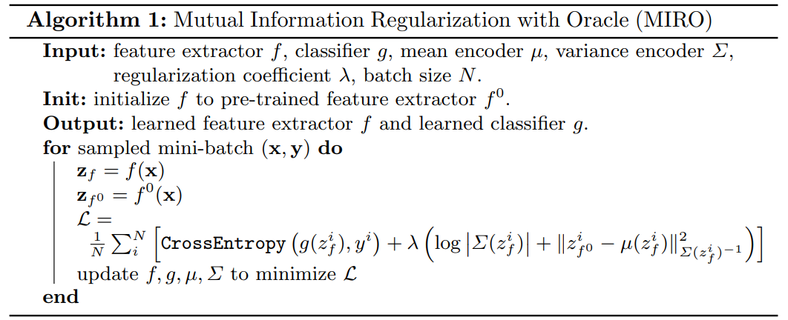

Slide 24
Design of the mean and variance encoder
mean encoder : identity function
variance encoder : a bias-only model with diagonal covariance
More complicated architectures has been tested, but only computational cost was increased without performance improvement.

Slide 25
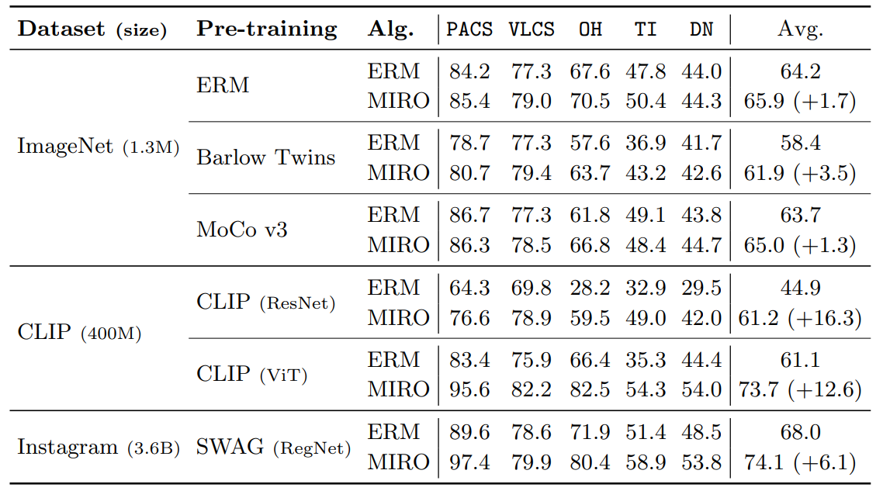
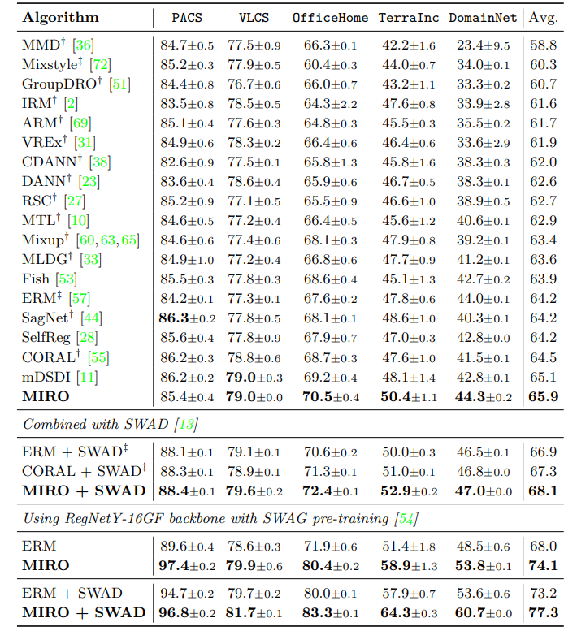
Experiments

Slide 26
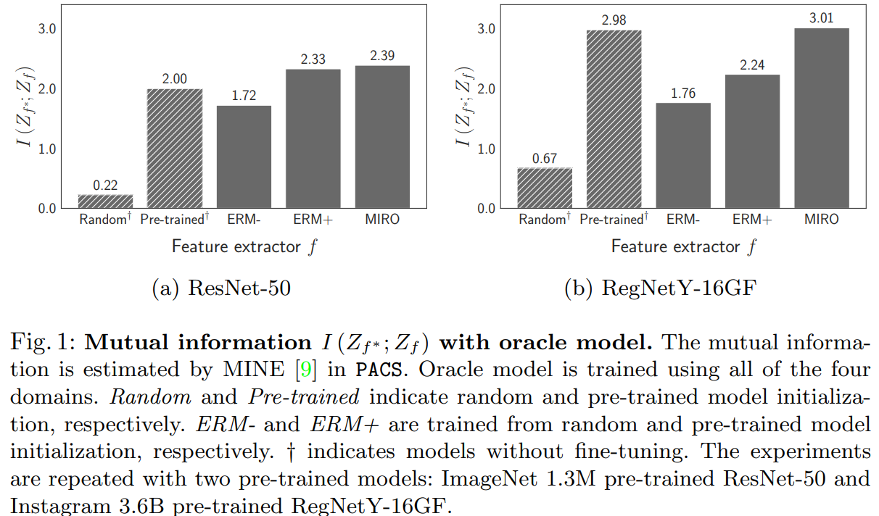
MI analysis with the oracle model

Slide 27
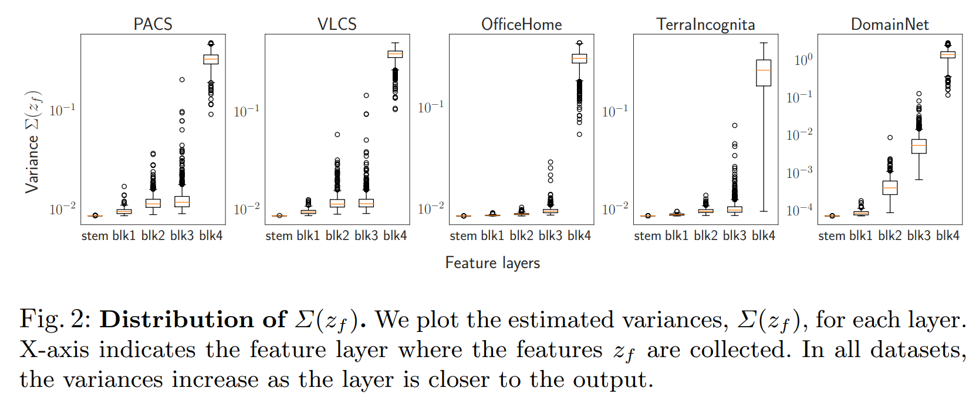
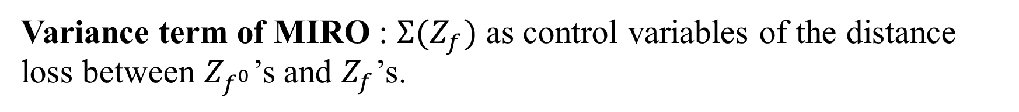
Loss Function Interpretation
Variance term of MIRO : $Σ(Z_{f})$ as control variables of the distance loss between $Z_{f^{0}}$’s and $Z_{f}$’s.
“Pre-trained information is preserved well in lower layers, while task-specific new information is learned in higher layers. This result is consistent with the interpretation that high layer features represent more task-specific semantic information than low layer features; task shifts during fine-tuning make higher layer features learn more semantics than lower layers.”

Slide 28
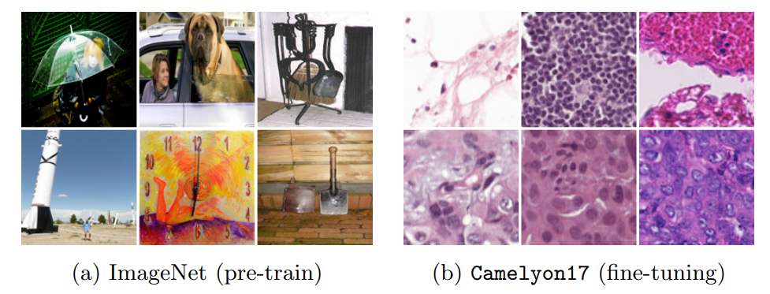
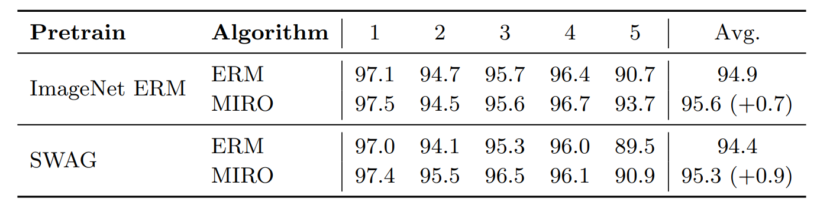
Case Study on Cameylon-17
Case with a large shift between pre-trained and target datasets: medical dataset, Cameylon-17
Large gap between the pre-training distribution (ImageNet or Instagram-3.6B) and the fine-tuning distribution (Camelyon17)

Slide 29
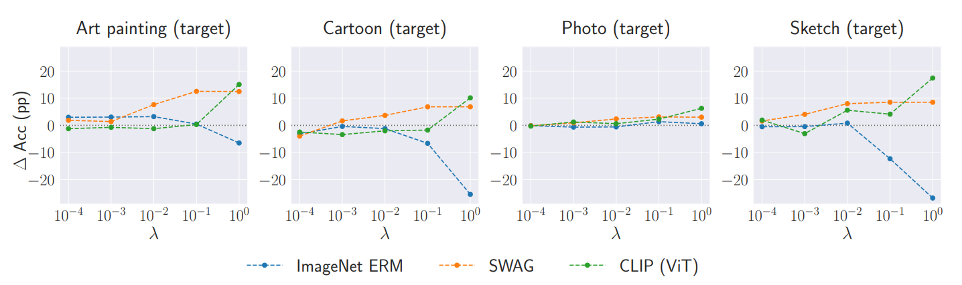

Interpretability of $λ$

Slide 30
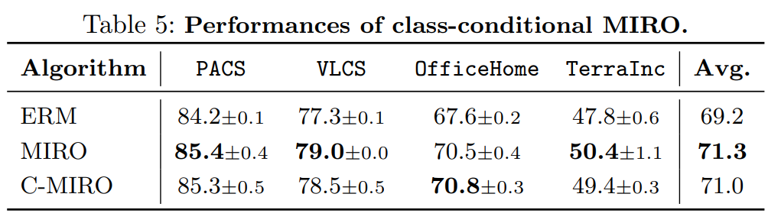
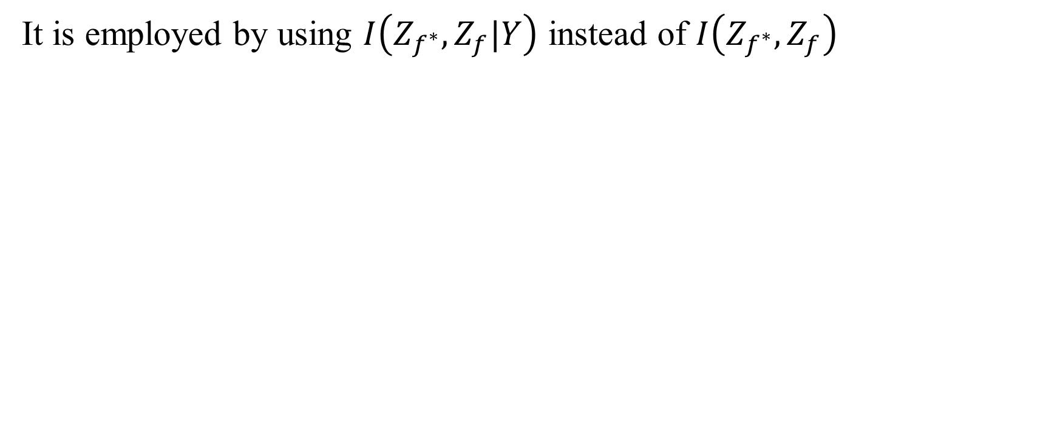
Class Conditional MIRO (C-MIRO)
It is employed by using $I\left(Z_{f^{∗}},Z_{f}|Y\right)$ instead of $I\left(Z_{f^{∗}},Z_{f}\right)$

Slide 31
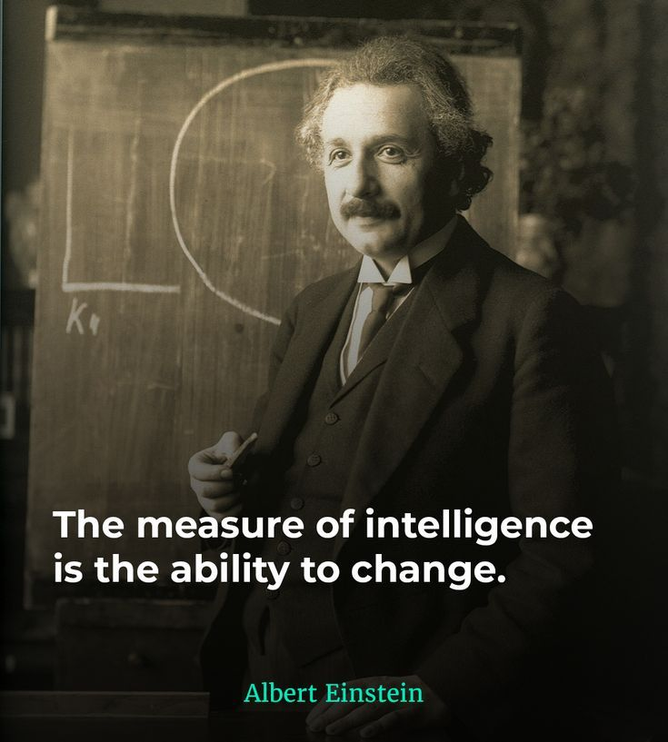

Slide 32
References
[1] Ishaan Gulrajani and David Lopez-Paz. In search of lost domain generalization. In ICLR, 2021
[2] Nguyen, T., Do, K., Duong, B. and Nguyen, T., 2024. Domain generalisation via risk distribution matching. In Proceedings of the IEEE/CVF Winter Conference on Applications of Computer Vision (pp. 2790-2799).
[3] ha, J., Lee, K., Park, S., Chun, S.: Domain generalization by mutual-information regularization with pre-trained models. In: Computer Vision–ECCV 2022: 17th European Conference, Tel Aviv, Israel, October 23–27, 2022, Proceedings, Part XXIII. pp. 440–457. Springer (2022)
[4] Koh, P.W., Sagawa, S., Marklund, H., Xie, S.M., Zhang, M., Balsubramani, A., Hu, W., Yasunaga, M., Phillips, R.L., Gao, I. and Lee, T., 2021, July. Wilds: A benchmark of in-the-wild distribution shifts. In International conference on machine learning (pp. 5637-5664). PMLR. (Figures in Slide 9)
[5] Albuquerque, I., Naik, N., Li, J., Keskar, N. and Socher, R., 2020. Improving out-of-distribution generalization via multi-task self-supervised pretraining. arXiv preprint arXiv:2003.13525. (Figure in Slide 8)
[6] Teterwak, P., Saito, K., Tsiligkaridis, T., Saenko, K. and Plummer, B.A., 2023. Erm++: An improved baseline for domain generalization. arXiv preprint arXiv:2304.01973. (Figure in Slide 25)
[7] Wang, J., Lan, C., Liu, C., Ouyang, Y., Qin, T., Lu, W., Chen, Y., Zeng, W. and Philip, S.Y., 2022. Generalizing to unseen domains: A survey on domain generalization. IEEE transactions on knowledge and data engineering, 35(8), pp.8052-8072. (Figure in Slide 3)

Slide 33
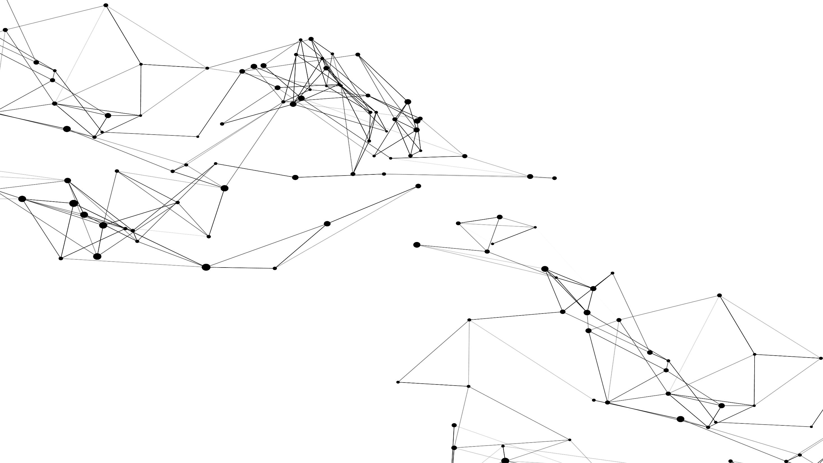
The End,
Thank You!

